Slide 1
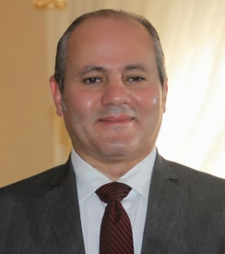
GM
Walid El Kirdawy
Smash Tennis Academy
25 YEARS OF EXPERIENCE IN THE HOSPITALITY FIELD
Sports
Manager
F&B
Manager
Customer Service Manager
Accounting Manager
Admin & Facility Manager
Communication Rep.
112
60
9
13
67
1

Slide 2

GM
Shehab Mohamed
Smash Kattameya Residence Club
21 YEARS OF EXPERIENCE IN THE HOSPITALITY FIELD
Sports
Manager
F&B
Manager
Customer Service Manager
Accounting Manager
Admin & Facility Manager
Communication Rep.
39
42
4
10
42
1

Slide 3



















ادارة الأندية
ادارة الأنشطة الرياضيه
الإستشارات الفنية

Slide 4






Club MGMT Services
(Premium Segment)
Club MGMT Services (Below Premium Segment)
Sports Facility MGMT Premium Segment
Consultancy Services

